Slide 1

Tutorial

Slide 2










Various Deep Learning Toolkits

Slide 3
Deep Learning Toolkits Trend

Slide 4
Deep Learning Toolkits Trend

Slide 5
Chapter 1: Tensor
TensorFlow 2 Tutorial
Chapter 1
Tensor
Tensor

Slide 6
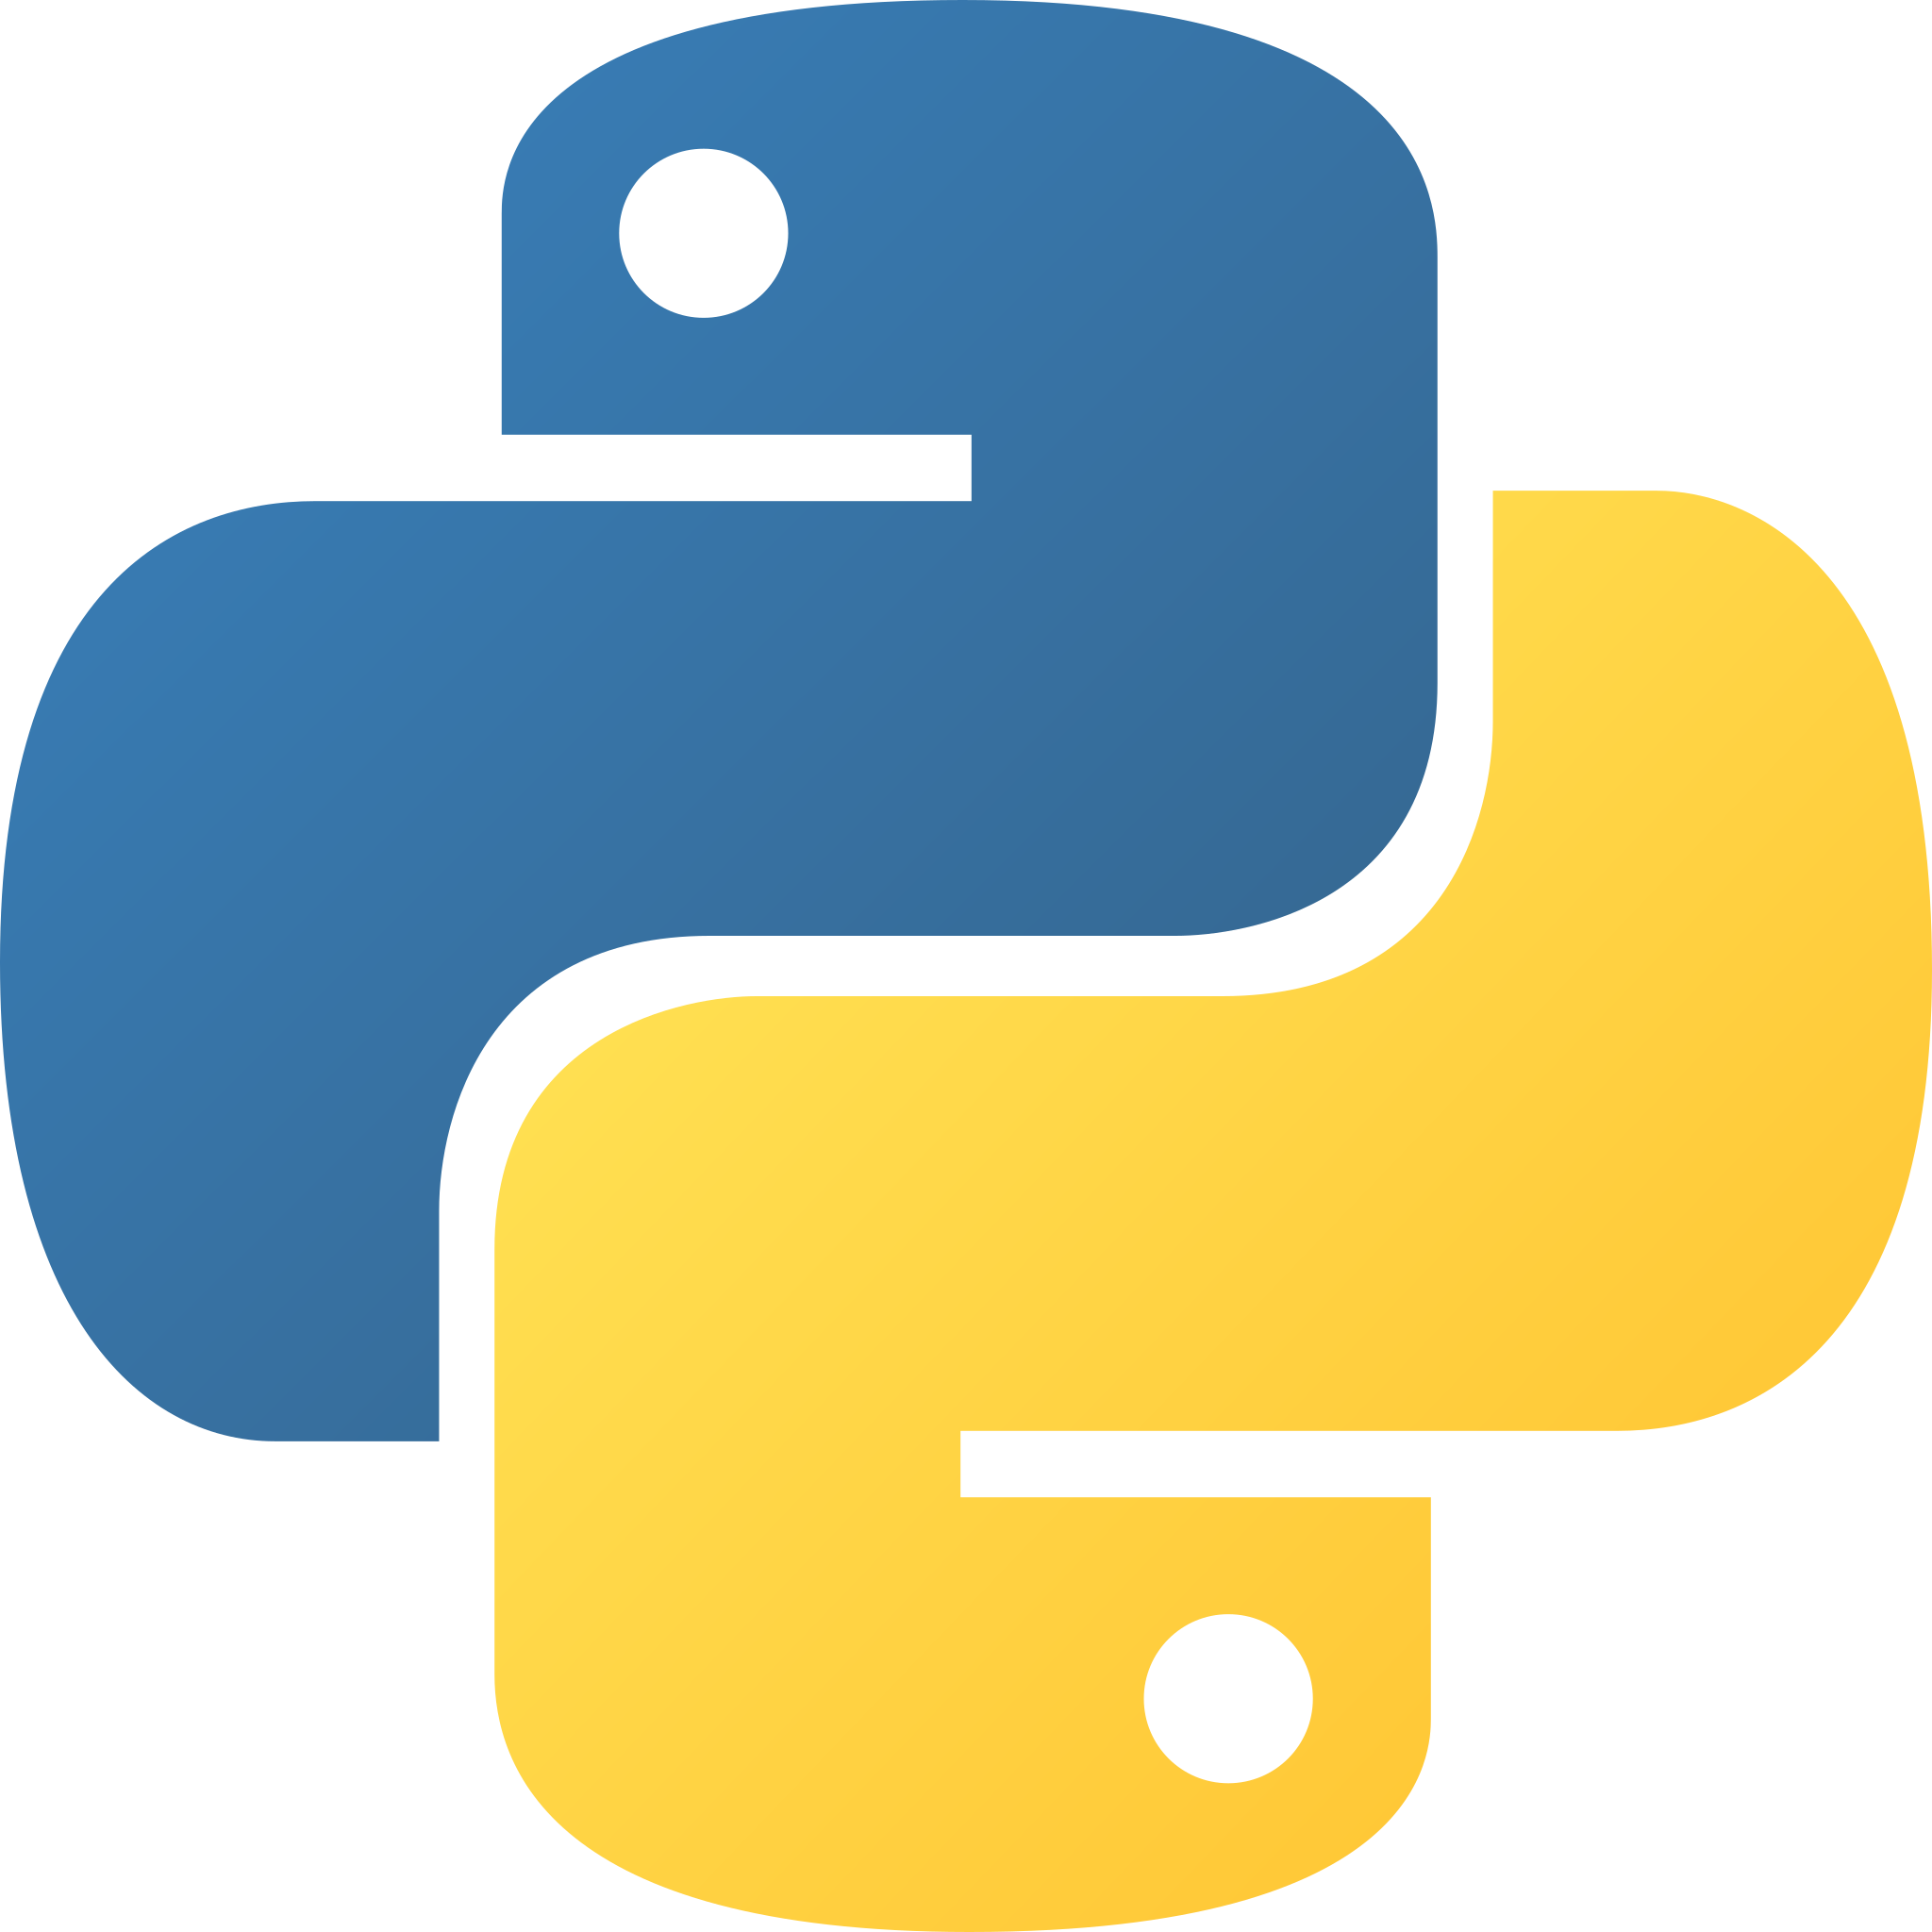
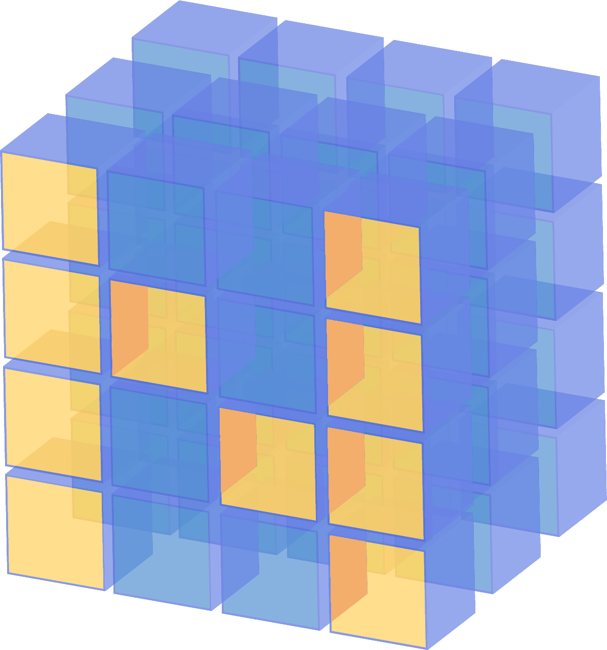
Container
Python
Numpy
Tensorflow 2
list
tuple
dict
ndarray
Tensor

Slide 7
Container
x = tf.constant([1, 2, 3, 4])
x = np.array([1, 2, 3], dtype=np.float32)
x = tf.constant(np.array([1, 2, 3]))
x = np.array([1, 2, 3]).tolist()
x = tf.constant([1, 2, 3]).numpy()

Slide 8

Chapter 2: Datasets
TensorFlow 2 Tutorial
Chapter 2
Datasets

Slide 9

Chapter 2: Neural Networks
TensorFlow 2 Tutorial
Chapter 3
Neural Networks

